Slide 1
Chapter Nine
New-Product Development and Product Life-Cycle Strategies

Slide 2
New-Product Development and Product Life-Cycle Strategies
Topic Outline
New-Product Development Strategy
The New-Product Development Process
Managing New-Product Development
Product Life-Cycle Strategies
Additional Product and Service Considerations

Slide 3
New-Product Development Strategy
Two ways to obtain new products
Acquisition refers to the buying of a whole company, a patent, or a license to produce someone else’s product
New product development refers to original products, product improvements, product modifications, and new brands developed from the firm’s own research and development

Slide 4
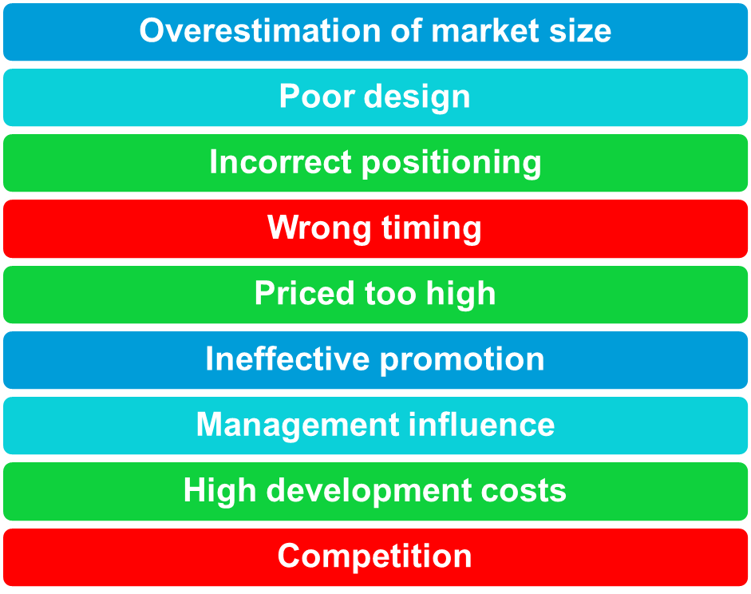
New-Product Development
Reasons for new product failure

Slide 5
New Product Development Process
Marketing
Strategy
Business
Analysis
Concept
Development
and Testing
Product
Development
Idea
Screening
Test
Marketing
Idea
Generation
Commercialization
Notes:
New Product Development Process
This CTR corresponds to Figure 9-1 on p. 275 and relates to the discussion on pp. 275-286.
Stages in New Product Development
Idea Generation. This stage is the systematic search for new product ideas. Sources for new product ideas include internal sources, customers, competitor's products, distributors & suppliers, and other sources.
Screening. This stage focuses on reducing the number of ideas by dropping poor ideas as soon as possible. This helps reduce costs and focus attention more productively.
Concept Development and Testing. This stage involves translating ideas into product concepts or detailed versions of the ideas stated in meaningful consumer terms. Concepts are then tested on target consumers.
Marketing Strategy. This stage consists of three parts. The first part describes the target market, the second part outlines the product's projected price, distribution, and budget for the first year, the third part describes long-term sales, profit goals, and marketing mix strategy.
Business Analysis. This stage reviews the sales, costs, and profit projections for the product to find out if they satisfy overall company objectives.
Product Development. This stage involves bringing the product concept into existence as a physical product to ensure that the idea is a workable product.
Test Marketing. This is the stage at which the product and marketing program are implemented in one or more realistic market settings.
Commercialization. This stage involves actually introducing the new product into the competitive marketplace. In this stage, the company must make decisions involving when to introduce, where, to whom, and how.

Slide 6
The New-Product Development Process
Idea Generation
Idea generation is the systematic search for new-product ideas
Sources of new-product ideas
Internal
External

Slide 7
New-Product Development Process
Idea Generation
Internal sources refer to the company’s own formal research and development, management and staff.
External sources refer to sources outside the company such as customers, competitors, distributors, suppliers, and outside design firms

Slide 8
New-Product Development Process
Idea Screening
Identify good ideas and drop poor ideas
R-W-W Screening Framework:
  Is it real?
  Can we win?
  Is it worth doing?

Slide 9
New Product Development Process
Idea Screening
Process to spot good ideas and drop poor ones as soon as possible.
Many companies have systems for rating and screening ideas which estimate:
  Market Size
  Product Price
  Development Time & Costs
  Manufacturing Costs
  Rate of Return
Then, the idea is evaluated against a set of general company criteria.

Slide 10



1. Develop Product Ideas into
Alternative
Product Concepts
New Product Development Process
Concept Development & Testing
2. Concept Testing - Test the
Product Concepts with Groups
of Target Customers
3. Choose the Best One

Slide 11
New Product Development Process
Marketing Strategy Development
Marketing Strategy Statement Formulation
Part One Describes Overall:
Target Market
Planned Product Positioning
Sales & Profit Goals
Market Share
Part Two Describes Short-Term:
Product’s Planned Price
Distribution
Marketing Budget
Part Three Describes Long-Term:
Sales & Profit Goals
Marketing Mix Strategy

Slide 12


Business Analysis
Review of Product Sales, Costs,
and Profits Projections to See if
They Meet Company Objectives
New Product Development
Process Business Analysis
Product Development
If No, Eliminate
Product Concept
If Yes, Move to
Product Development

Slide 13
New-Product Development Process
Test marketing is the stage at which the product and marketing program are introduced into more realistic marketing settings
Provides the marketer with experience in testing the product and entire marketing program before full introduction

Slide 14
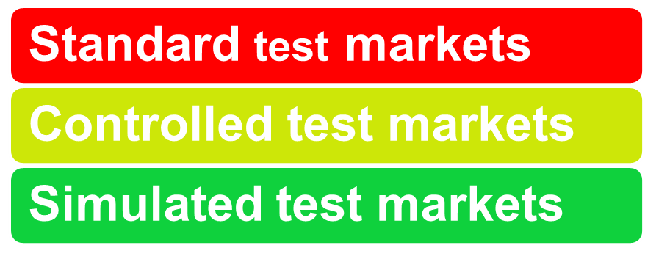
New-Product Development Process
Types of Test Markets

Slide 15
New Product Development Process
Step 7. Test Marketing
Standard
Test Market
Full marketing campaign
in a small number of
representative cities.
Controlled
Test Market
A few stores that have
agreed to carry new
products for a fee.
Simulated
Test Market
Test in a simulated
shopping environment
to a sample of
consumers.
Notes:
Test Marketing
This CTR relates to the discussion on pp. 282-284.
Test Marketing
Standard Test Markets. Under this approach, the company finds a small number of representative test cities, conducts a full marketing campaign in those cities, and then measures and evaluates performance. This provides a “real world” picture of how the product performs. But there are drawbacks. Standard testing is expensive, long, and tips competitors to company strategy.
Controlled Test Markets. This approach uses a research firm that has designated store placement space for their clients. Participating stores receive a fee. Some services like Scantrack (Nielsen) and BehaviorScan (IRI) offer computerized monitoring of individual consumer panels whose television viewing is cross-tabulated with store purchases. Controlled testing is quicker and less expensive than standard testing. Concerns revolve around representativeness of the test markets (small size) and tipping off competitors.
Simulated Test Markets. This approach creates a simulated shopping environment by the company or research firm. Consumers are exposed to promotions and then given money to shop with. Purchase patterns are observed and consumers are interviewed afterward by researchers. Simulated test marketing is inexpensive and quick. Representativeness and demand characteristics are concerns and this approach might be used as a pretest for a go-no go decision on further testing.

Slide 16
TEST MARKETING
STANDARD
Expensive
Exposed to competitors
Generalized campaign
CONTROLLED
Less expensive
More precise shelf placement, price, In store environment
In depth view
Less generalizability
SIMULATED
Least expensive
Controlled environment
Post purchase enquiries
Least generalizability

Slide 17
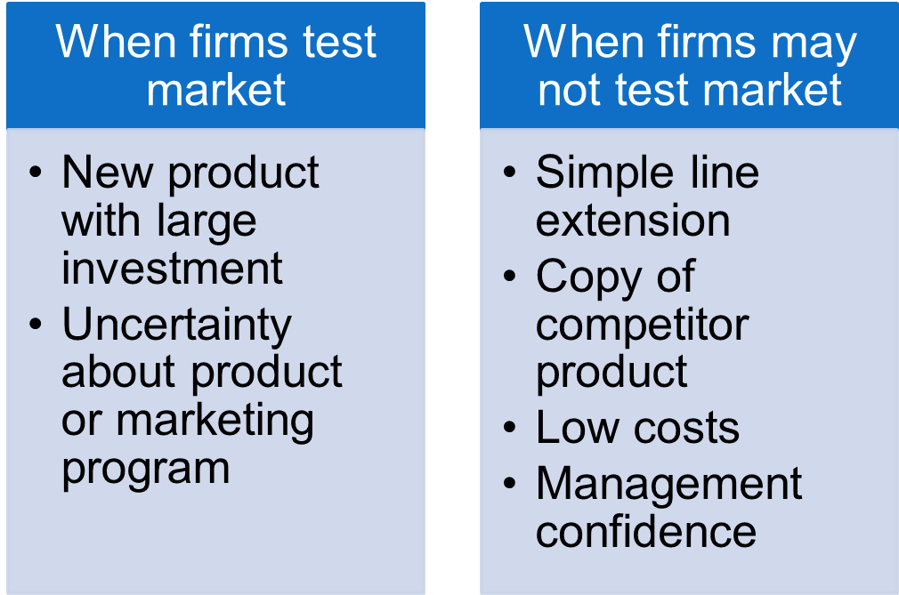
New-Product Development Process
Marketing Strategy Development

Slide 18





New Product Development Process
Commercialization
Commercialization is the Introduction of the New Product into the Marketplace.
When?
Where?
To
Whom?
How?

Slide 19
Managing New-Product Development
New-Product Development Strategies
Customer-centered new product development focuses on finding new ways to solve customer problems and create more customer satisfying experiences
Begins and ends with solving customer problems

Slide 20
Managing New-Product Development
New-Product Development Strategies
Sequential new-product development is a development approach where company departments work closely together individually to complete each stage of the process before passing along to the next department or stage
Increased control in risky or complex projects
Slow

Slide 21
Managing New-Product Development
New-Product Development Strategies
Simultaneous new-product development is a development approach where company departments work closely together in cross-functional teams, overlapping in the product-development process to save time and increase effectiveness

Slide 22


Speeding Up Development
Step 1
Sequential
Simultaneous
Step 2
Step 1
Step 2
Step 3
Step 3
Step 4
Step 4
Notes:
Speeding Up Development
This CTR relates to the material on p. 286-287.
Speeding Up New-Product Development
Sequential Product Development. Isolated groups in each stage work on the new product until the stage is completed. This completed stage is then passed to the next group or department to begin its stage in the process. This organization brings control to complex development projects and reduces the risk associated with costly mistakes. But it is also extremely slow and subjects the company to greater competitive risk and potential lost sales while the process is completed.
Simultaneous Product Development. This approach organizes new product development into a more flexible integration of each stage in the process. Simultaneous organization features close communication and coordination of departments and groups working on different stages, more overlap of work on steps to save time and increase effectiveness. Coordination facilitates each stage benefiting from the developmental process of the other stages while still planning what the product should be and will become.

Slide 23
Product Life Cycle
Sales and Profits Over the Product’s Life From Introduction to Decline
Sales and
Profits ($)
Sales
Profits
Time
Product
Develop-
ment
Introduction
Growth
Maturity
Decline
Losses/
Investments ($)
Notes:
The Product Life-Cycle
This CTR corresponds to Figure 9-2 on p. 288 and relates to the material on pp. 287-293.
Instructor’s Note: This CTR can be used to overview the life cycle concept. Strategies appropriate for each stage are discussed on the following CTRs.
Product Life Cycle Stages
Product Development. Development begins when the company finds and develops a new product idea. During development the product has costs but no sales. Development costs must be strategically weighed against the projected length of the product's PLC.
Introduction. During the introduction of new products initial sales growth is slow as the market is just becoming aware of the product. Profits are usually nonexistent at this stage due to heavy promotional spending.
Growth. This stage is characterized by rapid market acceptance of the product and increasing profits.
Maturity. In maturity there is a slowdown in sales growth as the product has achieved acceptance by most potential customers. Profits may level off or decline as marketing costs increase to defend existing market share.
Decline. In this period sales begin to fall off and profits decline dramatically.

Slide 24
Introduction Stage of the PLC
Summary of Characteristics, Objectives, & Strategies
Sales
Low sales
Costs
High cost per customer
Profits
Negative
Marketing Objectives
Create product awareness
and trial
Product
Offer a basic product
Price
Use cost-plus
Distribution
Build selective distribution
Advertising
Build product awareness among early adopters and dealers
Notes:
Introduction. In this stage marketers spend heavily on promotions to inform the target market about the new product's benefits. Low or negative profits may encourage the company to price the product high to help offset expenses. companies can concentrate on skimming strategies to generate high profits now or on penetration strategies to build market share and dominant the market for larger profits once the market stabilizes.
Product Life Cycle Strategies
Product Life-Cycle Strategies
This CTR relates to the material on pp. 289 and 293.

Slide 25
Growth Stage of the PLC
Summary of Characteristics, Objectives, & Strategies
Sales
Rapidly rising sales
Costs
Average cost per customer
Profits
Rising profits
Marketing Objectives
Maximize market share
Product
Offer product extensions, service, warranty
Price
Price to penetrate market
Distribution
Build intensive distribution
Advertising
Build awareness and interest in the mass market
Notes:
Product Life-Cycle Strategies
This CTR relates to the material on pp. 289-290 and 293.
Product Life-Cycle Strategies
Growth. In this stage the company experiences both increasing sales and competition. Promotion costs are spread over larger volume and strategic decisions focus on growth strategies. Strategies include adding new features, improving quality, increasing distribution, and entering new market segments.

Slide 26
Maturity Stage of the PLC
Summary of Characteristics, Objectives, & Strategies
Sales
Peak sales
Costs
Low cost per customer
Profits
High profits
Marketing Objectives
Maximize profit while defending
market share
Product
Diversify brand and models
Price
Price to match or best competitors
Distribution
Build more intensive distribution
Advertising
Stress brand differences and benefits
Notes:
Product Life Cycle Strategies
Maturity. In this stage the company must manage slower growth over a longer period of time. Strategic decisions made in the growth stage may limit choices now. Marketing managers must proactively seek advantage by either market modification to increase consumption, product modification to attract new users (quality, feature, and style improvements), or marketing mix modification in an attempt to improve competitive position.
Product Life-Cycle Strategies
This CTR relates to the material on pp. 290-292 and 293.

Slide 27
Decline Stage of the PLC
Summary of Characteristics, Objectives, & Strategies
Sales
Declining sales
Costs
Low cost per customer
Profits
Declining profits
Marketing Objectives
Reduce expenditure and nourish the brand
Product
Phase out weak items
Price
Cut price
Distribution
Go selective: phase out unprofitable outlets
Advertising
Reduce to level needed to retain
very loyal customers
Notes:
Product Life-Cycle Strategies
This CTR relates to the material on pp. 292-293.
Product Life Cycle Strategies
Decline. In this stage the costs of managing the product may eventually exceed profits. Rate of decline is a major factor in setting strategy. Management may maintain the brand as competitors drop out, harvest the brand by reducing costs of support for short term profit increases, or drop the product (divest) altogether.

Slide 28
Additional Product and Service Considerations
Product Decisions and Social Responsibility
Public policy and regulations regarding developing and dropping products, patents, quality, and safety

Slide 29
Additional Product and Service Considerations
International Product and
Services Marketing—Challenges
Determining what products and services to introduce in which countries
Standardization versus customization
Packaging and labeling
Customs, values, laws

